Slide 1
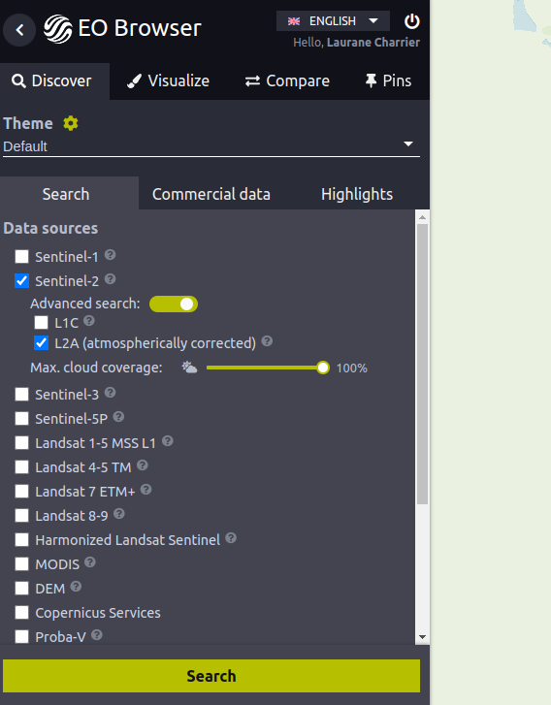
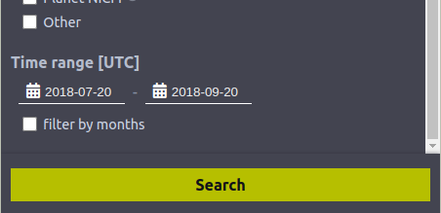
Image selection

Slide 2
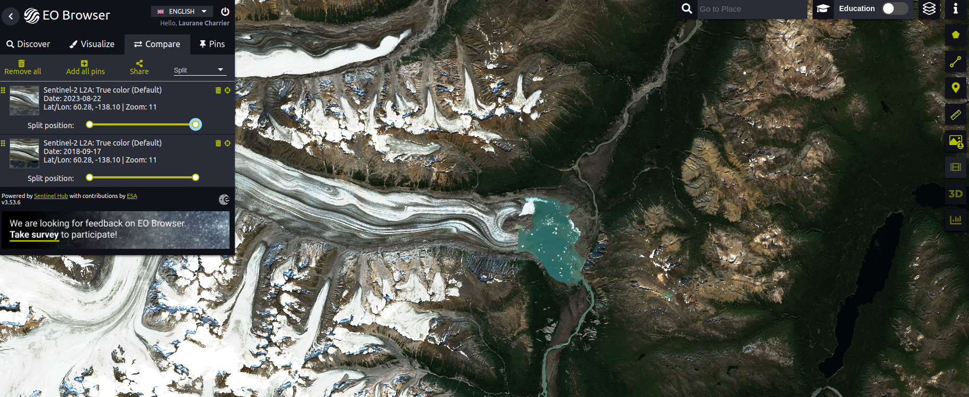
Comparaison of two images

Slide 3
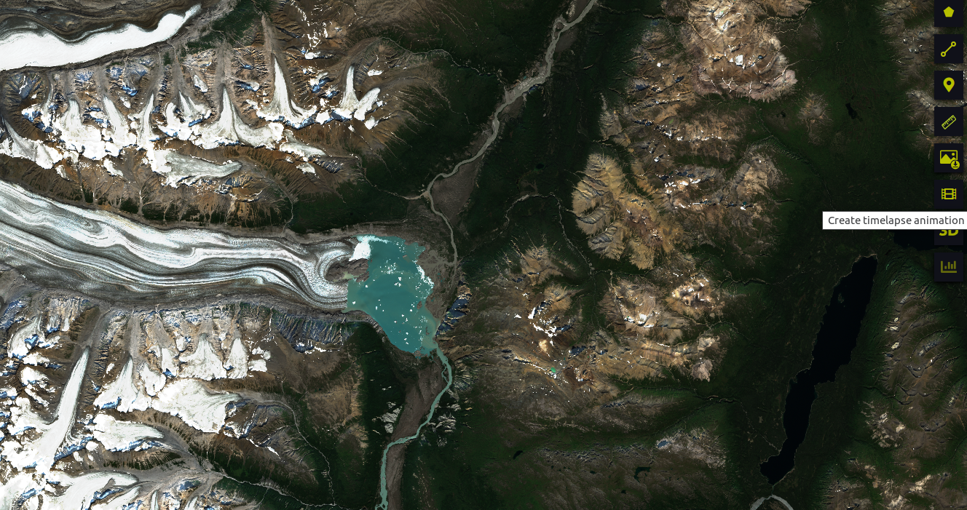
Time laps

Slide 4
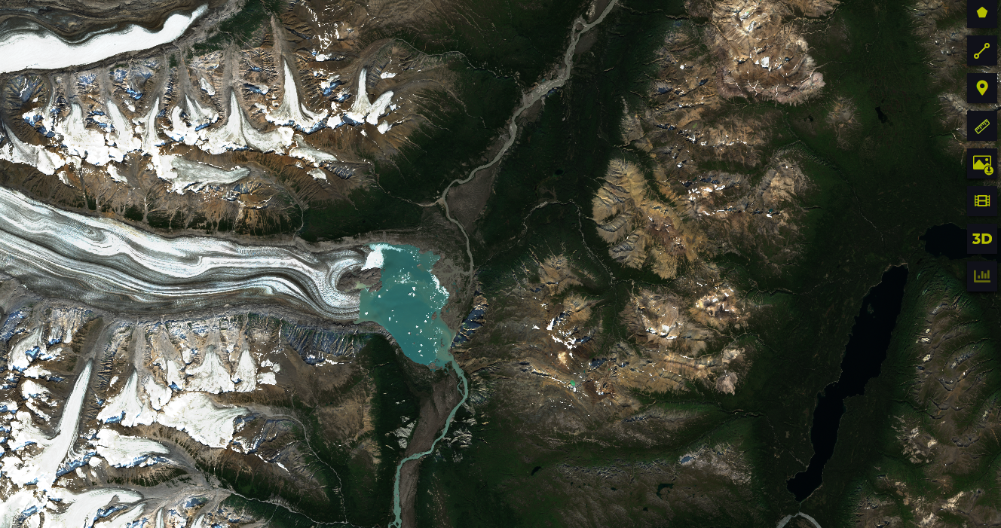
3D view
clic here for 3D view

Slide 5
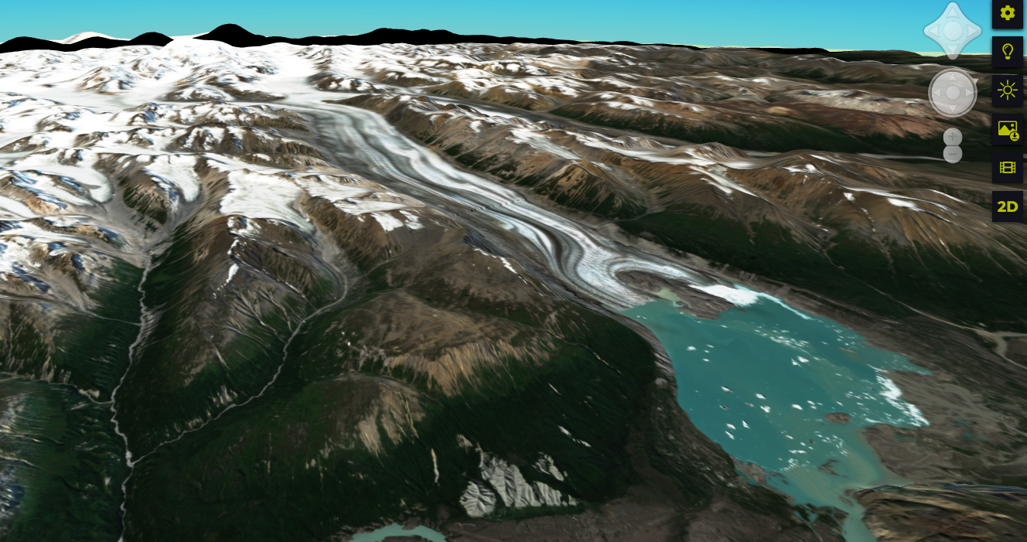
3D view
change date and hour of the day to see illumination change

Slide 6
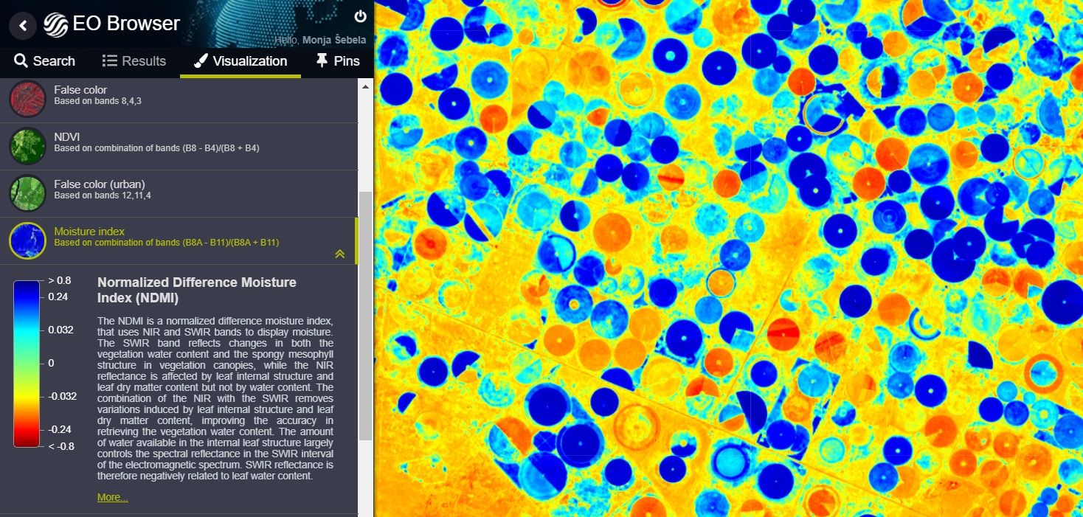
Index
NDVI, NDMI, NDWI

Slide 7
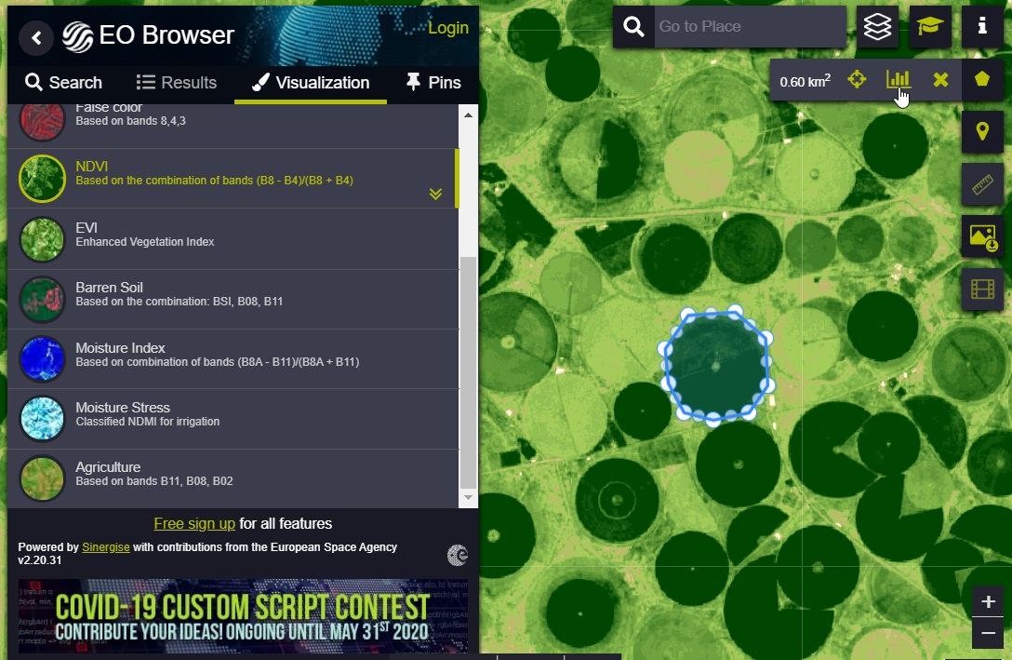
Time series
draw an (AOI)
clic on stastical info

Slide 8
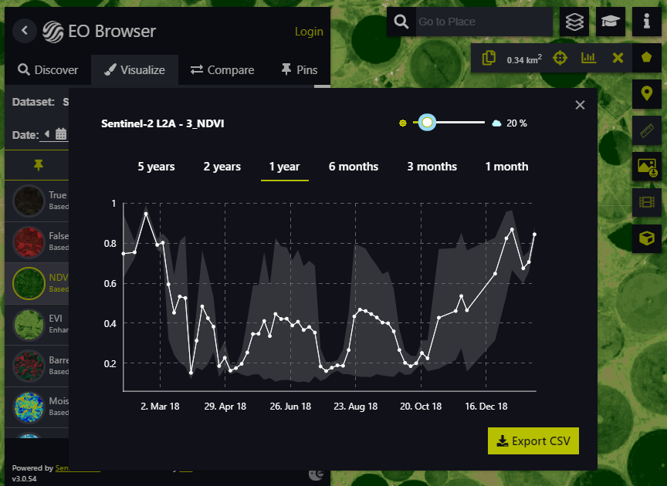
Time series

Slide 9
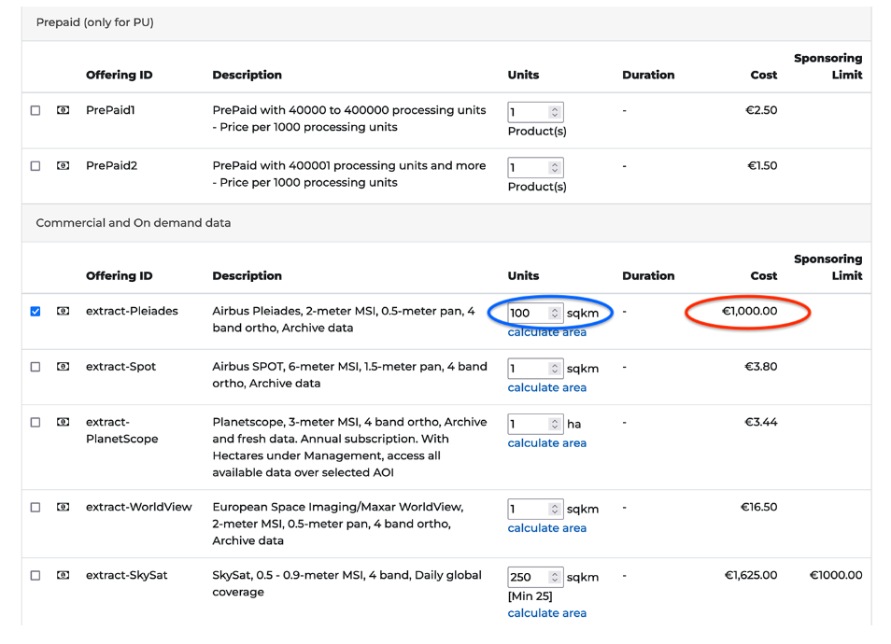
Commercial images
To apply for a grant from ESA : https://www.sentinel-hub.com/Network-of-Resources/

Slide 10
QGIS plugin
https://www.youtube.com/watch?v=SyNTdSNyFDI

